Slide 1
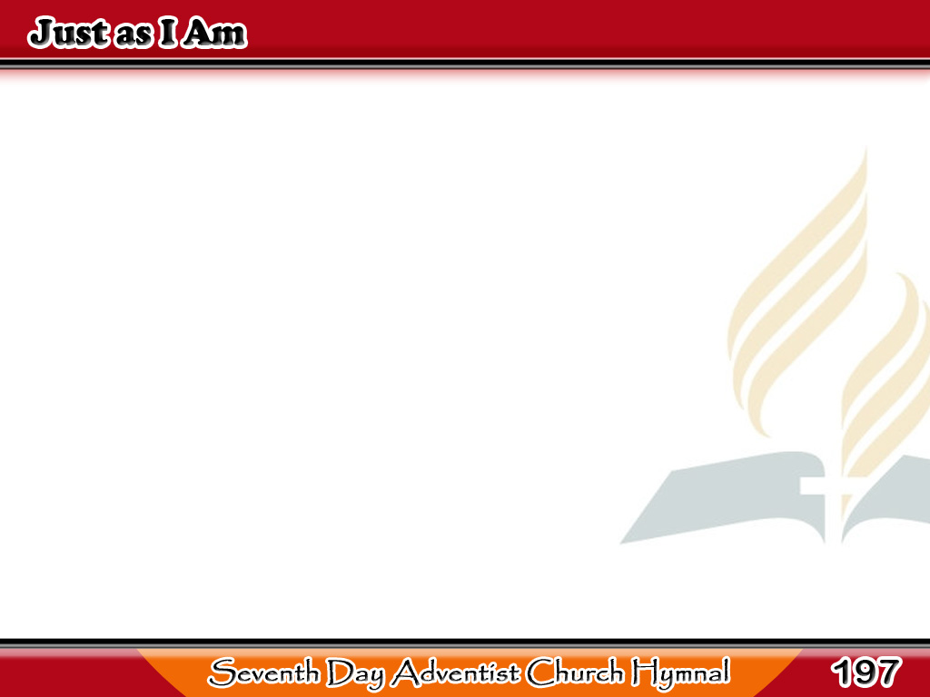
Aba Akong Di Gasino
Just as I am,
without one plea,
but that Thy blood
was shed for me,
1/6

Slide 2
Aba Akong Di Gasino
And that Thou bid’st me
come to Thee,
O Lamb of God,
I come, I come.
1/6

Slide 3
Aba Akong Di Gasino
Just as I am, and waiting not
To rid my soul of one dark blot,
To Thee whose blood
can cleanse each spot,
O Lamb of God, I come, I come.
2/6

Slide 4
Aba Akong Di Gasino
Just as I am,
though tossed about
With many a conflict,
many a doubt;
3/6

Slide 5
Aba Akong Di Gasino
“Fightings within,
and fears without,”
O Lamb of God,
I come, I come.
3/6

Slide 6
Aba Akong Di Gasino
Just as I am, poor,
wretched, blind;
Sight, riches, healing of the mind,
Yea, all I need, in Thee I find,
O Lamb of God, I come, I come.
4/6

Slide 7
Aba Akong Di Gasino
Just as I am, Thou wilt receive,
Wilt welcome, pardon,
cleanse, relieve;
Because Thy promise I believe,
O Lamb of God, I come, I come.
5/6

Slide 8
Aba Akong Di Gasino
Just as I am, Thy love I own
Has broken every barrier down;
Now to be Thine, and Thine alone,
O Lamb of God, I come, I come.
6/6

